Slide 1
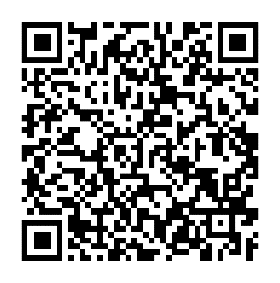
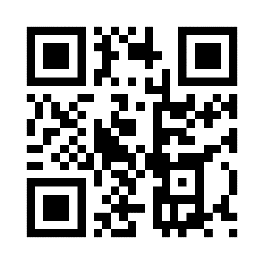
Students can work with Co-Pilots (Peer Tutors) in the Learning Commons and get help with:
Writing
Math
Group Work
Learning Skills
Languages
Sciences
Philosophy
History
Theology
School of Business
School of Engineering
School of Nursing
Schedule an Appointment
Drop-In Hours

