Slide 1
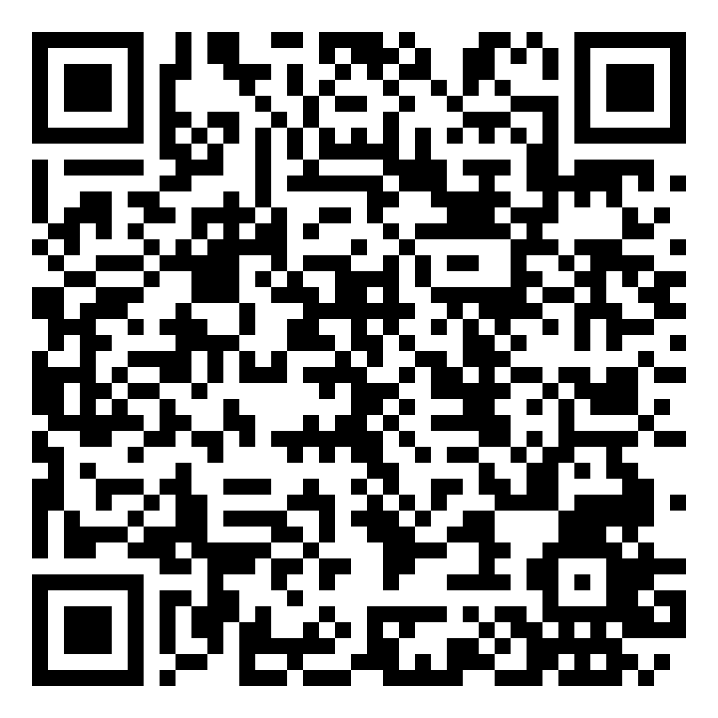
TUESDAYS
2:30pm – 3:00pm
PhL 150
Study groups
Learning
Commons
BC 163
with Learning Skills Co-Pilot
Audrey

Slide 2
What is a study group?
Weekly sessions to learn new study skills and work with classmates
Audrey will teach and lead discussion about a new study skill each week
There will be time to practice the study skill and apply it to PHL 150 coursework
Learning
Commons

Slide 3
Goals of Study Groups
Equip students with new study skills to help them be successful in all courses
Allow students time to practically implement each study skill into their courses and schedules
Give students an opportunity to collaborate with other Philosophy classmates
Learning
Commons

Slide 4
Skills covered in Study Groups
Time Management
Calendaring
Study Cycle
Pomodoro Method
Academic Reading
Concept Mapping
Note-Taking
Outlining
Concept Mapping
Annotating
Studying
Learning
Commons

Slide 5
Hope to see you at the next
Study Group
in the
Where: Learning Commons (BC 136)
When: Tuesdays 2:30pm – 3:30pm
Learning
Commons

