Slide 1
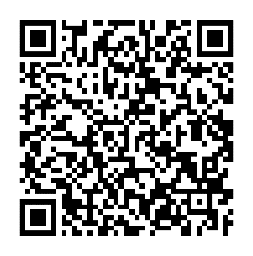
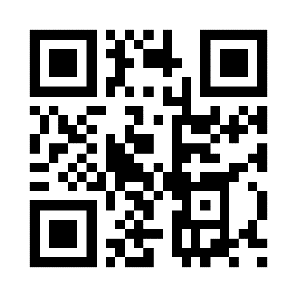
Physics Drop-In Hours
In the Learning Commons (BC 163)
PHY 201
Wednesdays: 5:30pm – 7:00pm
Thursdays: 4:00pm – 7:00pm
PHY 204
Mondays: 3:00pm – 4:00pm & 6:00pm – 7:00pm
Tuesdays: 3:00pm – 4:00pm
Wednesdays: 3:00pm – 5:00pm & 5:30pm – 7:00pm
Thursdays: 3:00pm – 7:00pm
PHY 205
Wednesdays: 3:00pm – 5:00pm & 5:30pm – 7:00pm
Thursdays: 4:00pm – 7:00pm
Students can work with Co-Pilots (Peer Tutors) in the Learning Commons during
Drop-In Hours or by Making an Appointment
Drop-In Hours
Schedule an Appointment

